Slide 1
Store Item Demand Forecasting
Team 8
Member: Wenhan Ji, Yu Ruan, Huanzhen Zhang, Hao Fu

Slide 2
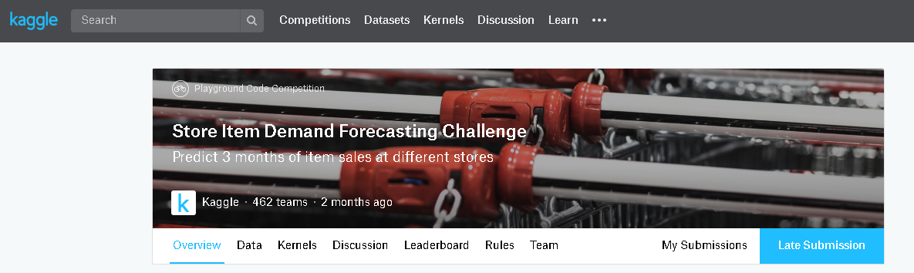
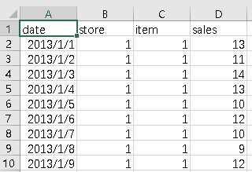
1. Introduction

Slide 3
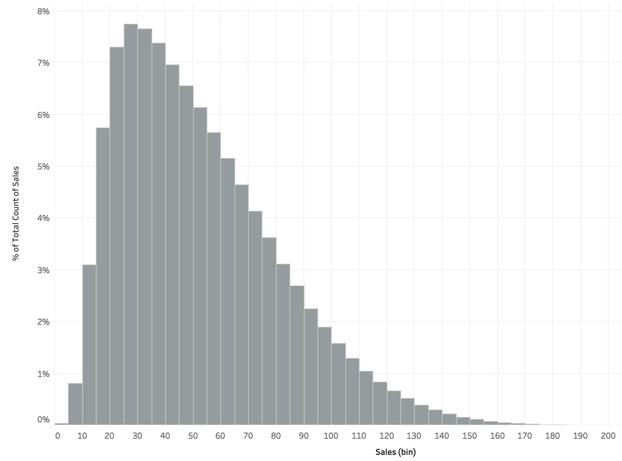
Sales histogram
2. Exploratory Data Analysis

Slide 4
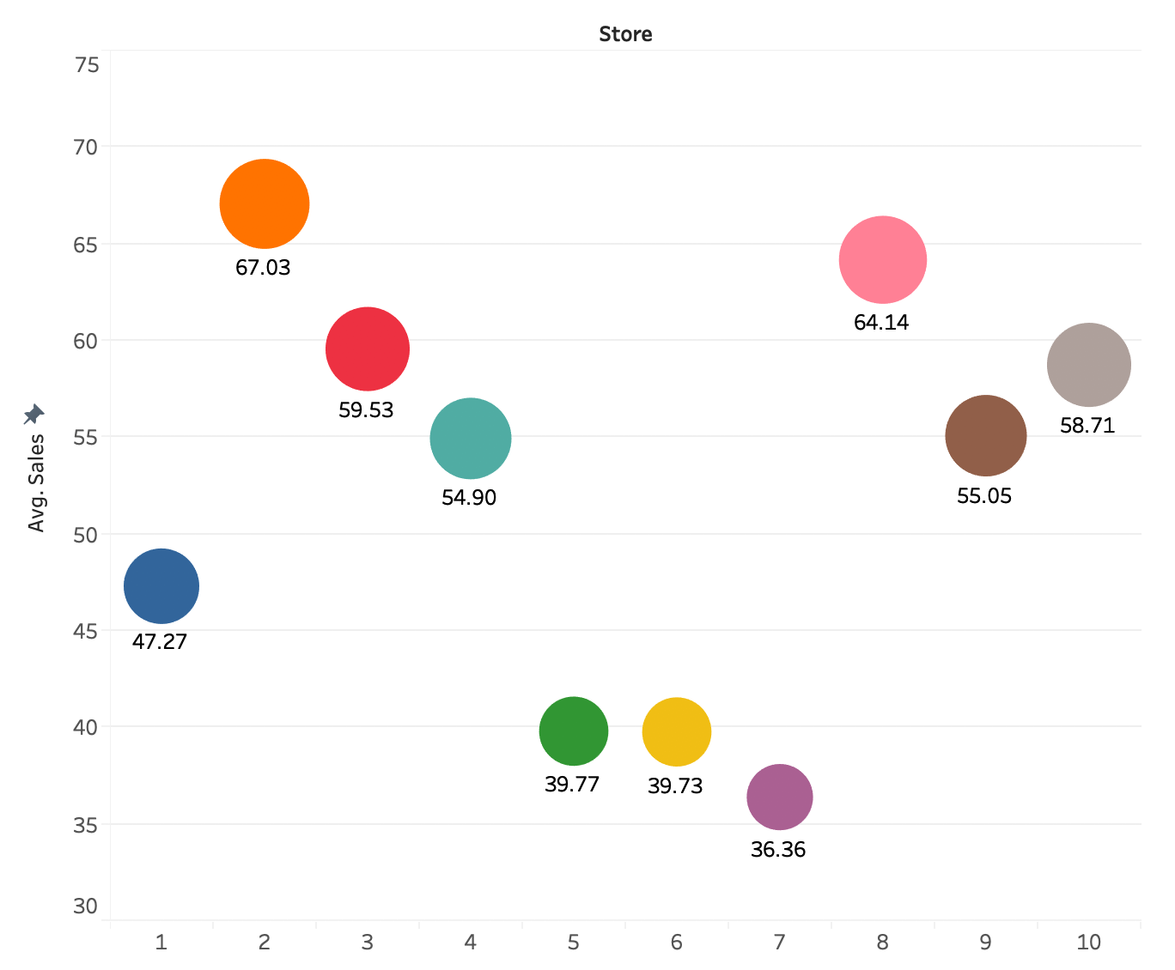
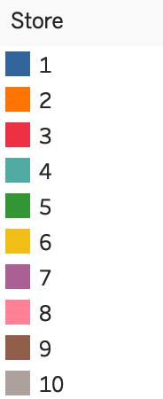
Sales of Stores
2. Exploratory Data Analysis

Slide 5
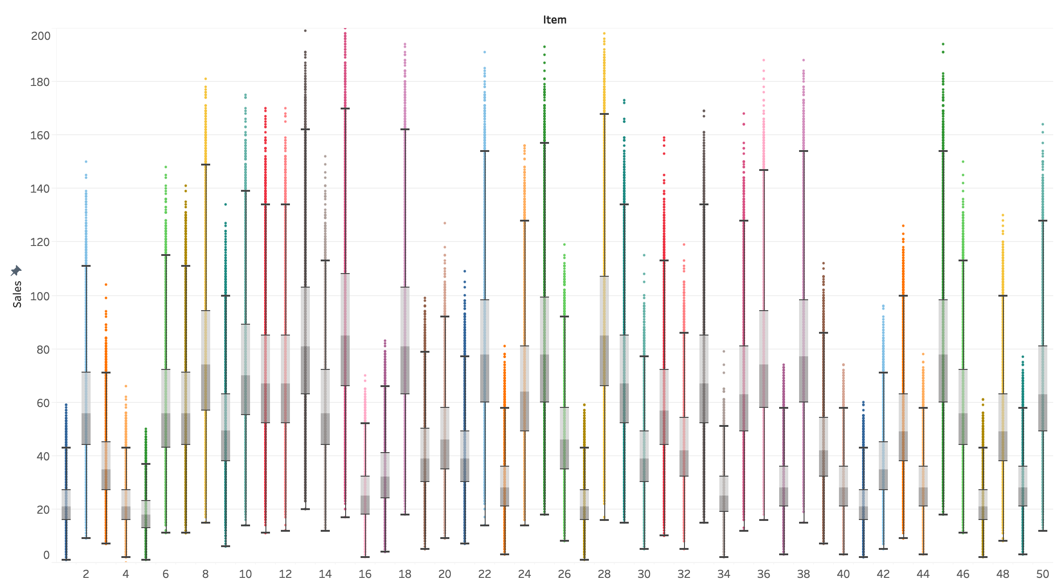
Sales distribution of items
2. Exploratory Data Analysis

Slide 6
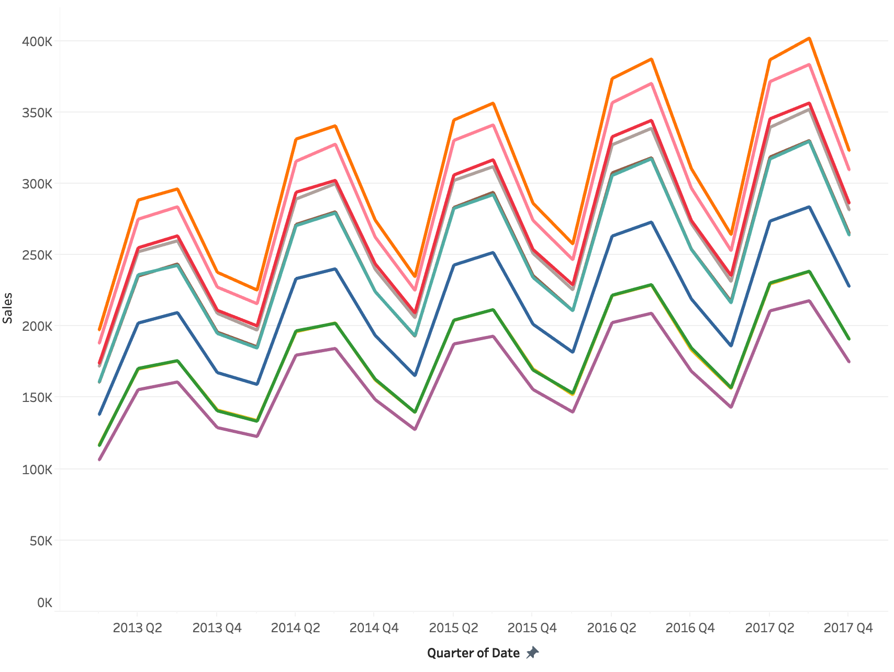
Sales trend of stores
2. Exploratory Data Analysis

Slide 7
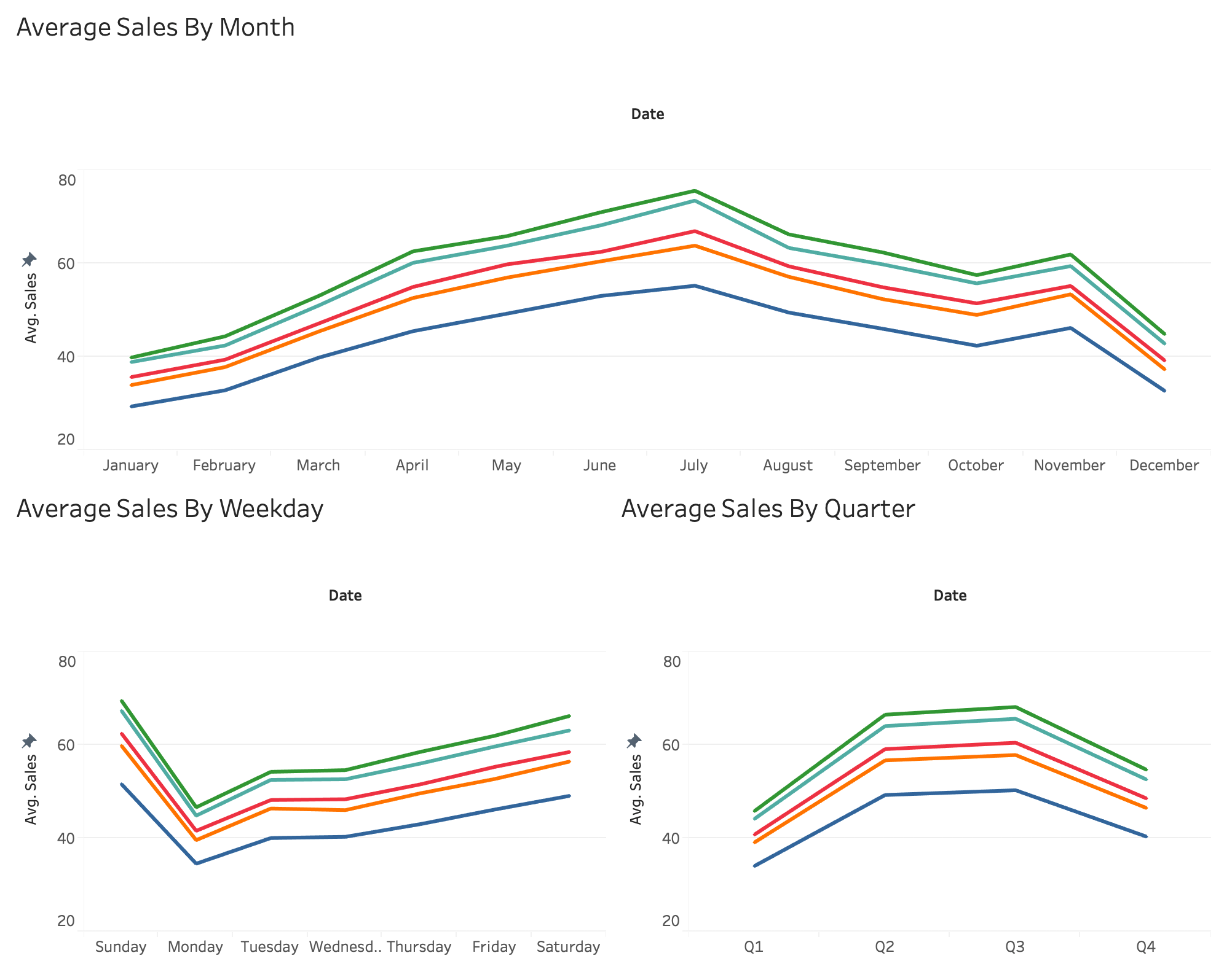
2. Exploratory Data Analysis Seasonality behind sales

Slide 8
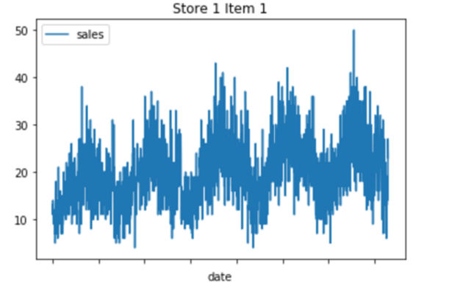
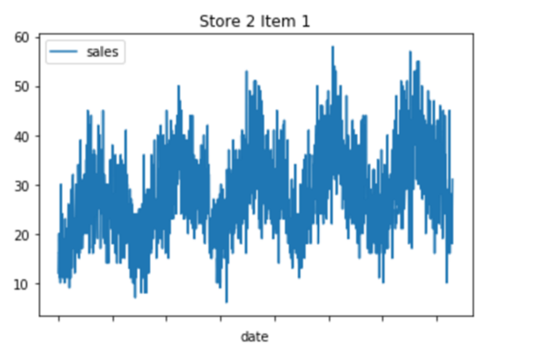
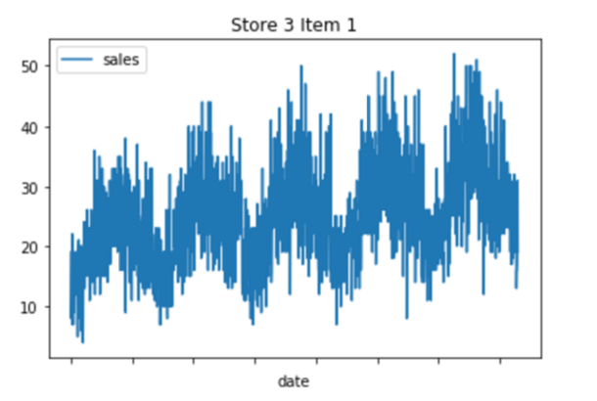
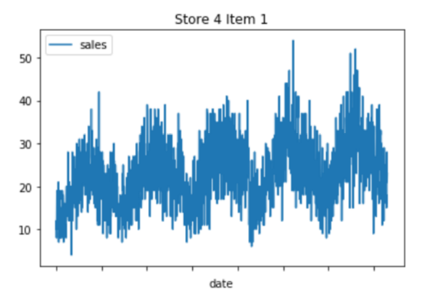
3. Time Series Analysis with Arima
For example: Item 1 in different store: (take four samples)

Slide 9
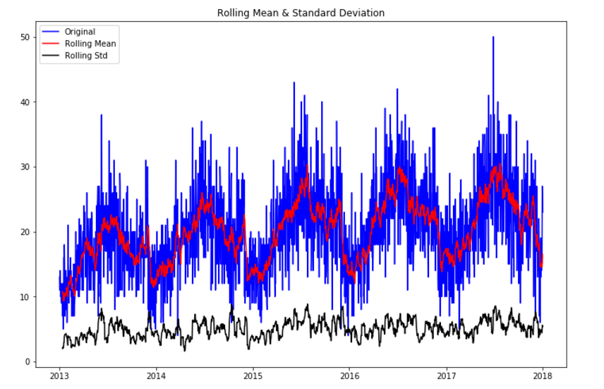
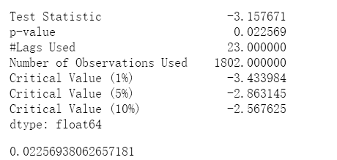
3. Time Series Analysis with Arima
Visualization and DF to test stationary

Slide 10
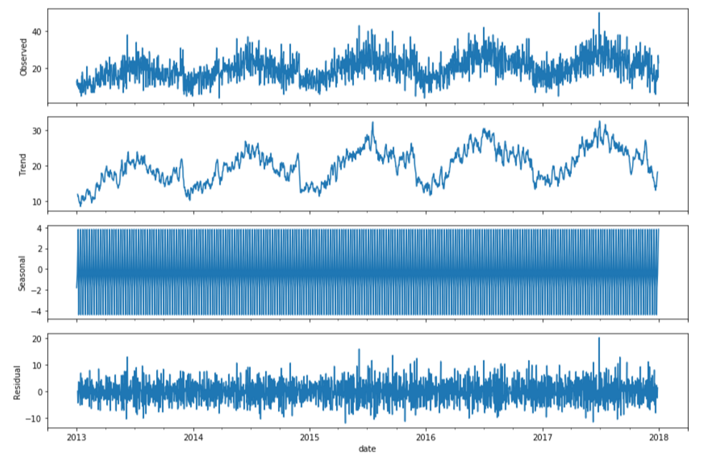
3. Time Series Analysis with Arima
Decompose the example time series into trend, seasonal, and residual components.

Slide 11
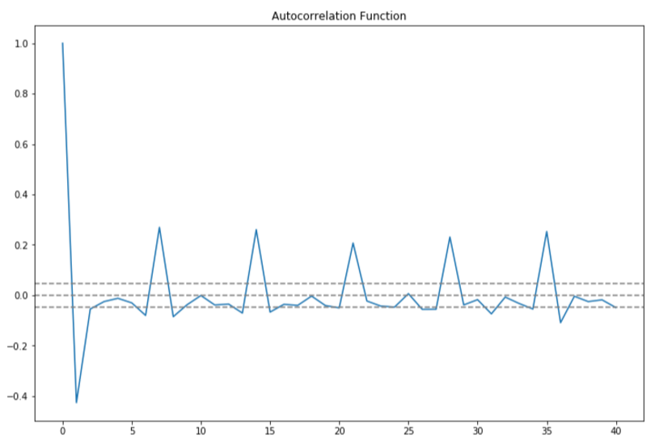
3. Time Series Analysis with Arima
determined p,q,d ---> (3,1,8)

Slide 12
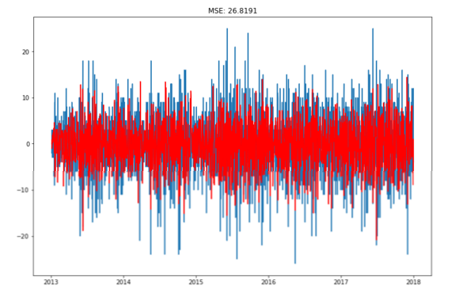
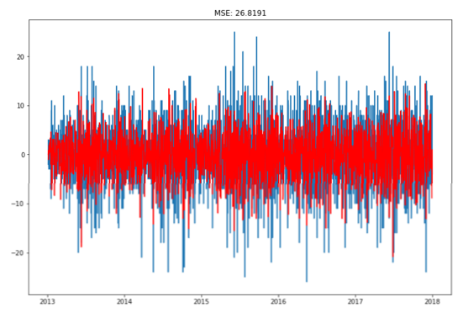
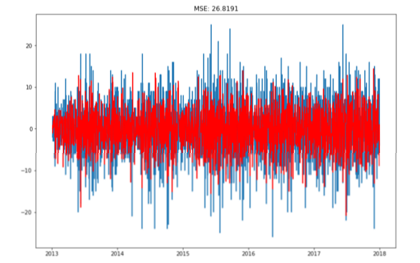
3. Time Series Analysis with Arima
AR
MA
ARIMA

Slide 13
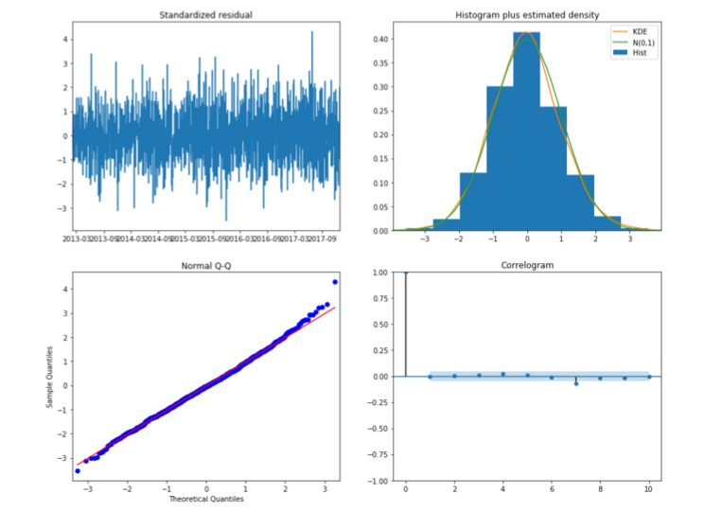
3. Time Series Analysis with Arima - Result evaluation

Slide 14
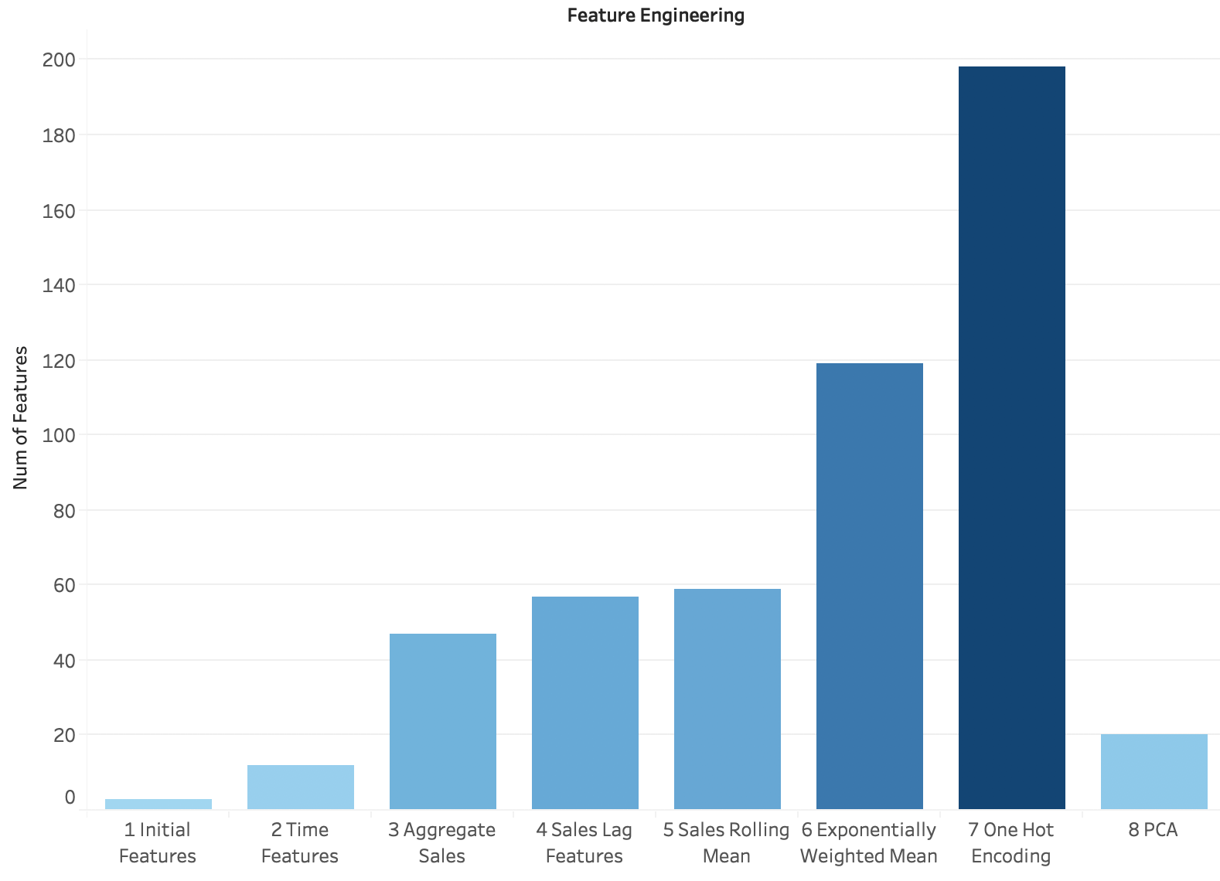
4. Feature Engineering

Slide 15
Feature Engineering: 1 Time Features
Month
Quarter
Year
Is Month Start
Is Month End
Day of Week
Day of Month
Day of Year
Week of Year

Slide 16
Feature Engineering: 2 Aggregate Sales
For store 1 item 1, what’s mean sales of first quarter?
For store 1 item 1, what’s sales standard deviation of each Monday?

Slide 17
Feature Engineering: 3 Sales Lag Features

Slide 18
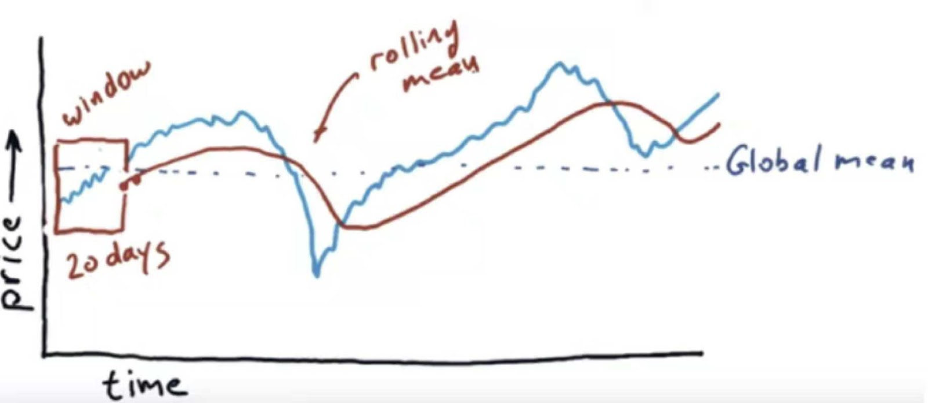
Feature Engineering: 4 Sales Rolling Mean

Slide 19
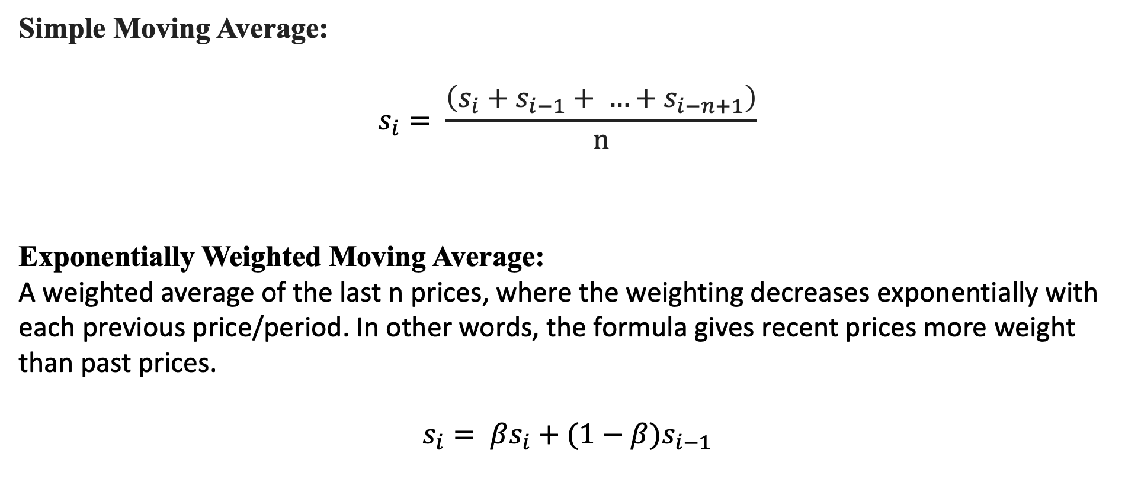
Feature Engineering: 5 Exponentially Weighted Moving Average with Lag
Simple Moving Average:
$$s_{i}= \frac{\left(s_{i}+s_{i−1}+ …+s_{i−n+1}\right)}{n}$$
Exponentially Weighted Moving Average:
A weighted average of the last n prices, where the weighting decreases exponentially with each previous price/period. In other words, the formula gives recent prices more weight than past prices.
$$s_{i}= βs_{i}+(1−β)s_{i−1}$$

Slide 20
Feature Engineering: 6 One Hot Encoding
Categorical Features: store, item, month, quarter, year

Slide 21
Feature Engineering: 7 Min Max Normalization

Slide 22
Feature Engineering: 8 PCA
Cumulative Explained Variance Rate
Explained Variance Rate

Slide 23
5. Train Test Split
Initial Trial: Whole 913,000 rows data, sample 70% as training set, 30% as test set.
Problem: Too slow to train the model.
Train Set Rows: 639,100
Test Set Rows: 273,900
Modified Version: For each item with 1826 rows data, sample 10% into training set, 90% into test set.
Train Set Rows: 91,000
Test Set Rows: 822,000
x 500

Slide 24
6. Model Training: R2 Score on Test Set

Slide 25
Grid Search and Cross validation: Lasso and KNN
Lasso search for optimal Alpha
KNN search for optimal K

Slide 26
6. Model Training Result: Without Normalization and PCA
Randy said we don’t have to apply PCA before training tree model

Slide 27
Grid Search and Cross validation: Random Forest & Gradient Boosting
Random Forest search for optimal n estimator
Gradient Boosting search for optimal n estimator

Slide 28
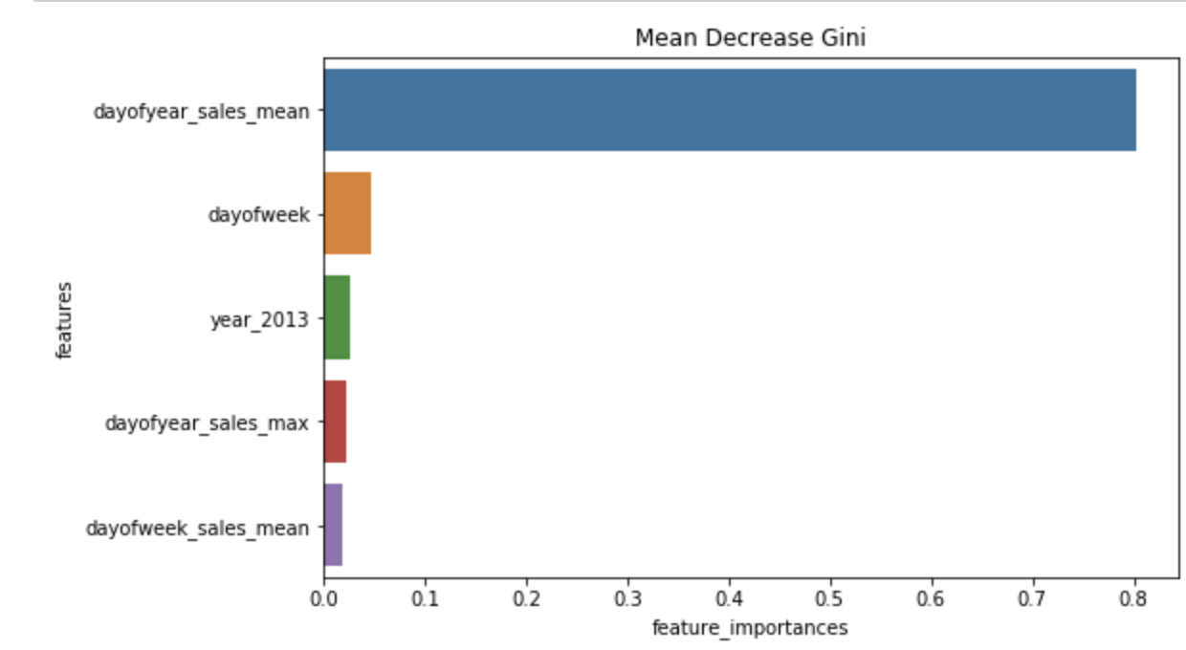
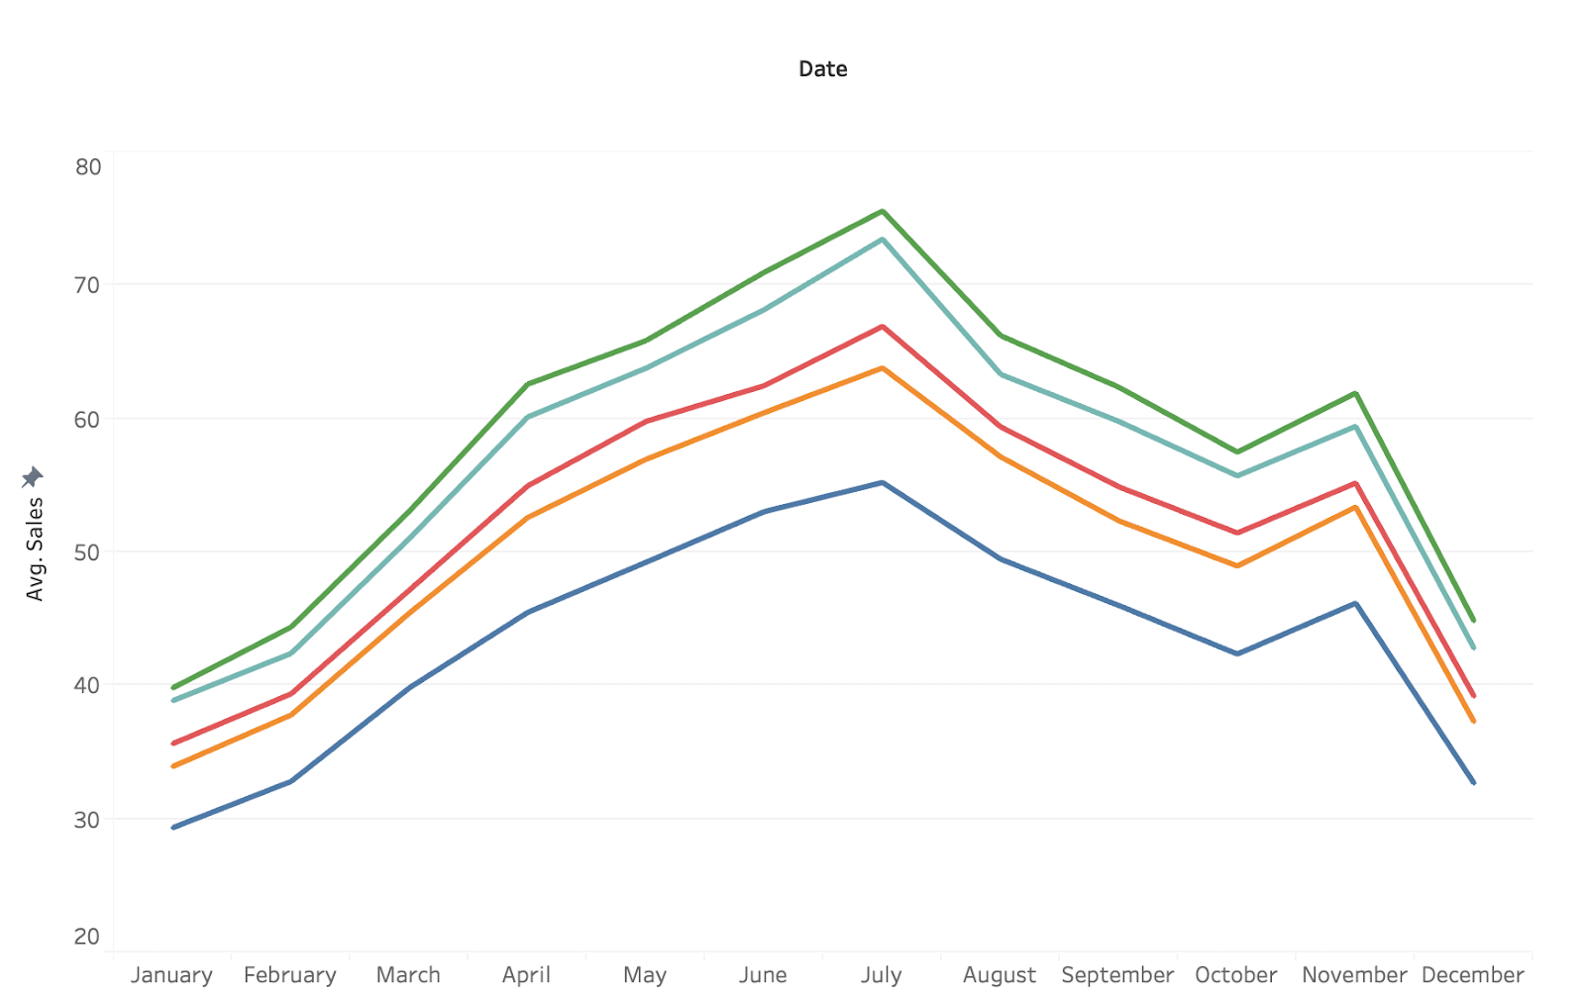
Best model: Random Forest

Slide 29
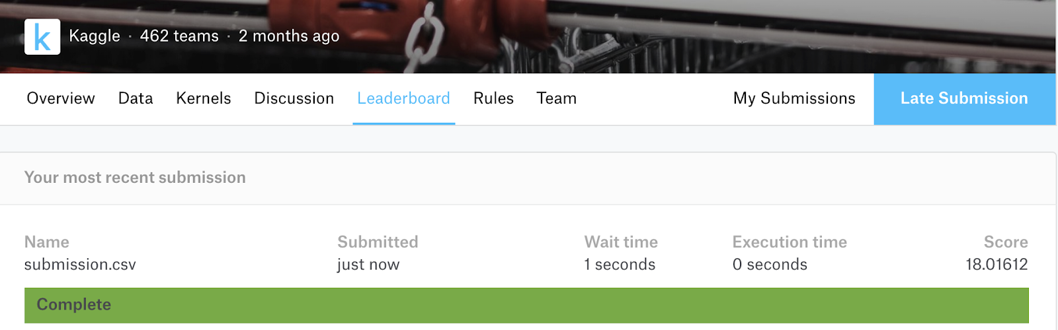
8.Predict on Kaggle’s Test Set
Symmetric Mean Absolute Percentage Error: 18.016

